Slide 1
An ML-Powered Energy Consumption Analyzer for SME Manufacturing
Guided By
Dr.M.SIVAKUMAR ,
Assistant Professor ,CSE,TCE
Presented by
KIRUBAKARAN S - 21078 HARIHARAN R - 21042
ARVIND B - 21016

Slide 2
Presentation Overview
Introduction
Literature Survey
Problem Statement
Objective
Existing System
Proposed System
Architecture Diagram
Timeline of Proposed System Activities
References

Slide 3
Introduction
Energy is one of the largest expenses in manufacturing industries.
SMEs often lack the tools and infrastructure to monitor energy usage effectively.
This results in inefficiencies, higher costs, and poor forecasting.
Our project aims to build a smart tool for product-wise energy tracking and forecasting.

Slide 4
Literature Survey- Top Relevant
Title | Problem Addressed | Proposed Solution | Pros | Cons
Machine Learning for Energy Efficiency in Manufacturing | Lack of Visibility Inefficient Processes Rising Energy Costs No Forecasting | Use Machine Learning (ML) to analyze historical energy consumption data and optimize manufacturing processes | Accurate Forecasting Cost Reduction Predictive Maintenance | Requires Quality Data Model Training Cost of Implementation

Slide 5
Objective
To build a smart software tool using machine learning that:
Records energy usage for individual products
Analyzes data trends and patterns
Predicts future consumption and cost
Suggests optimization paths to reduce energy waste

Slide 6
Problem Statement
Most SMEs lack affordable and intelligent tools to track energy consumption per product. This leads to hidden inefficiencies, unexpected costs, and no clear roadmap for optimization. An ML-powered tool is required to log, analyze, and forecast energy usage, making energy decisions more data-driven.

Slide 7
Datasets/Resources used for analysis
Datasets | References
Simulated SME Production Dataset | Self-created / Manually collected from SMEs
CSV Upload Support | Collected from SMEs or demo data
IoT Sensor Data | Generated via Arduino/ESP32 sensors

Slide 8
Existing System with Limitations
The reviewed works emphasize the importance of using Machine Learning (ML), IoT, and predictive analytics to enhance energy efficiency in manufacturing environments. Research shows that ML can optimize energy use, detect anomalies, and forecast future consumption. IoT integration supports automated data collection, enhancing real-time monitoring and control.
While these technologies have proven effective, most existing systems are tailored for large-scale industries. They often lack affordable, user-friendly solutions that cater to the unique needs of small and medium enterprises (SMEs).
The studies also highlight the need for tools that provide product-level energy tracking, cost forecasting, and actionable insights, which are rarely addressed in current solutions.

Slide 9
Proposed System
Approach to Solve the Problem
Step 1: Data Collection
Input product-wise energy usage (manual or CSV)
Capture machine, units produced, energy type & amount
Step 2: Energy Analysis
Calculate per-unit energy consumption
Identify high-consumption products/processes
Step 3: Forecasting
Estimate total energy & cost based on current trends
Predict monthly/annual energy expenses
Step 4: Insights & Alerts
Recommend energy-saving changes
Notify unusual spikes or inefficiencies
Step 5: Dashboard & Reports
Visual graphs and exportable reports
Simple UI for SME managers

Slide 10
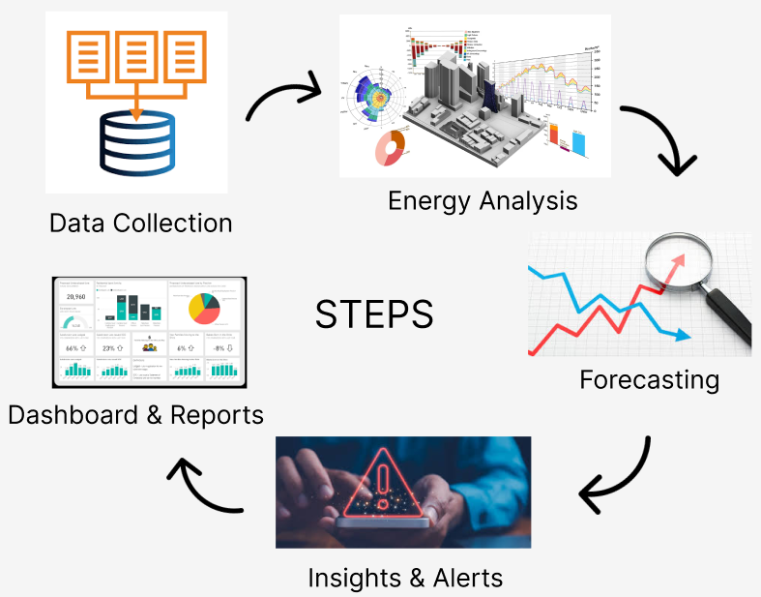
Architecture Diagram
Software
Frontend: React.js or Flutter
Backend: Node.js or Spring Boot
Database: MongoDB
Graphs: Chart.js
Hosting: Firebase, Vercel, or AWS

Slide 11
Contributions by Individual Team Members
Hariharan R – ML Model Development, Backend Logic
Kirubakaran S– UI Design, Frontend Integration
Arvind B – Data Collection, Testing, Report Preparation

Slide 12
Future Work
Integration with IoT energy meters
Extension to multi-factory scenarios
Dynamic pricing and carbon footprint tracking
Mobile app support

Slide 13


REFERENCES
1. https://www.mdpi.com/1996-1073/17/16/4144
2. https://doi.org/10.1016/j.energy.2024.131621
3. https://link.springer.com/article/10.1007/s10098-023-02606-z

Slide 14
Any Queries?

Slide 15
Thank You!!!

